Slide 1
CS 506 Spark! Project: Police Disciplinary Action - Mijente
Shelli Gorokhovsky, Rachel Peng, Tina Wang, Maya Webb, Daniel Delijani

Slide 2
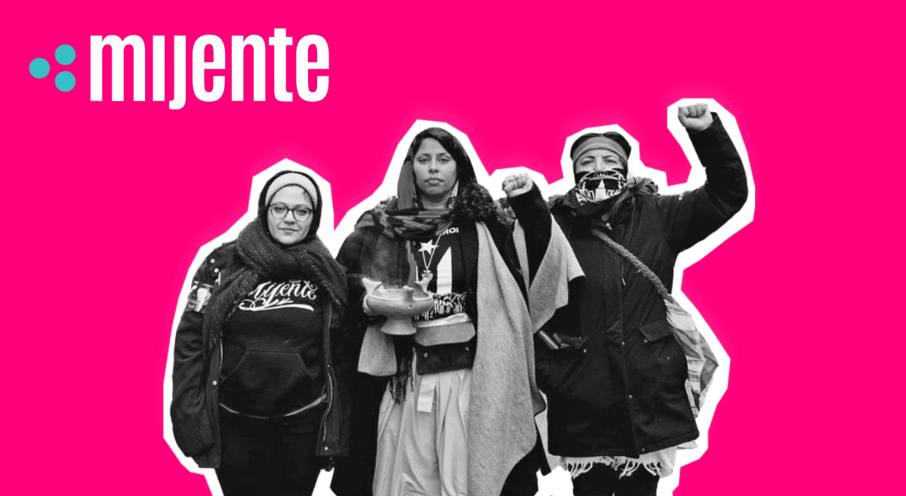
Background
Mijente is a political home for Latinx and Chicanx people who seek racial, economic, gender and climate justice.

Slide 3
Motivation
We want to understand how Boston Police Department officers under disciplinary investigation contribute politically to the Boston city council and Mayor.
How are they attempting to influence the internal investigations process through political contributions?

Slide 4
What have we done?
Step 1. Scraped Boston Globe database to retrieve police disciplinary action data
Step 2. Cleaned, preprocessed, and filtered our data
Step 3. Merged police disciplinary action information with data regarding recent officer contributions to political campaigns
Step 4. Overlayed final dataset with LEAD blacklist data
Step 5. Preliminary analysis: total contributions vs. indicted officer contributions

Slide 5
What have we found?
All BPD Officers | Indicted Officers
$823,368.20 from 3276 officers | $240,390 from 1439 officers

Slide 6
What were some challenges?
Police Disciplinary Action Dataset
Arthur J Hall-Brewster
Final Merged Dataset
Fuzzy Matching!
arthur j hall-brewster
Police Contributions Dataset
arthur j hall-brewster
Hall-Brewster , A J
arthur j hall-brewster
Hall-brewster, Arthur
Hall-brewster, Arthur

Slide 7
What to do next?
Analyze discrepancies and leading features that cause officers under investigation to contribute politically using logistic regression.
Complete visualizations for each of the features: race, rank, severity of misconduct of BPD officers under investigation and how they contributed politically.
→ What are the differences in how officers of different ranks, races/ethnicities, severity of misconduct contribute?

Slide 8
Thank you!

